Slide 1
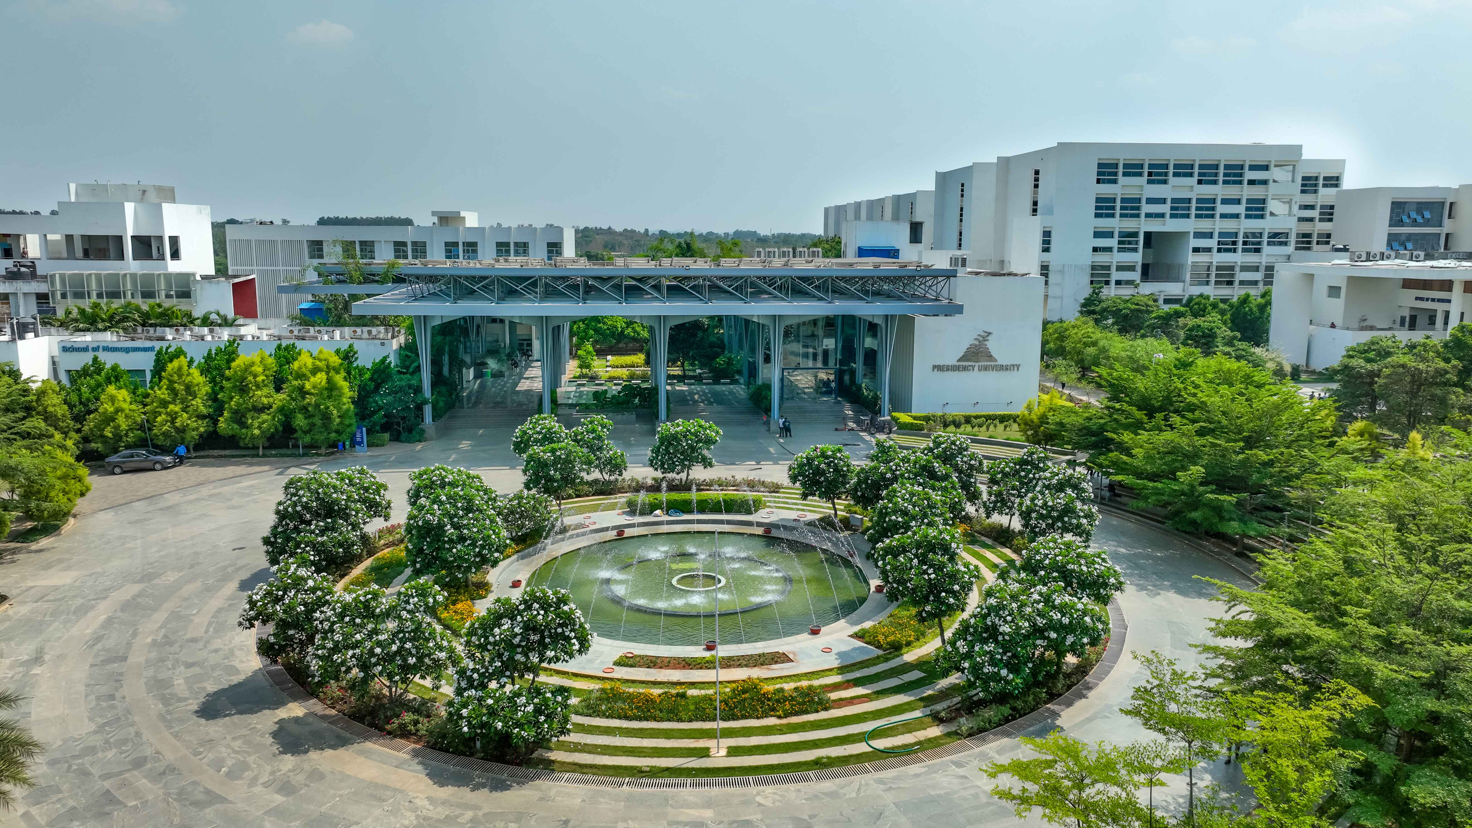

LIBRARY MANAGEMENt SYSTEM
ØWEB TECHNOLOGY PROJECT
Names | Roll Numbers
Sandhyana | 20241IST0070
S. Yashwanth Kumar | 20241IST0071
Sahil Raj | 20241IST0072
Premjith | 20241IST0073
Mansoor | 20241IST0074
Department: Computer Science and Engineering College Name: Presidency University

Slide 2

Digital Library Management
Transforming traditional libraries into efficient, technology-driven knowledge centers.
Digital systems make library services faster, smarter, and more accessible for students and staff.

Slide 3

THE CHALLENGES
Traditional library operations depend on manual work and paper-based records.
This causes slow cataloguing, long queues, misplaced books, and frequent errors.
Librarians spend more time on routine tasks instead of assisting readers and improving collections

Slide 4
VISION&OBJECTIVES
Our vision is to create a modern, fully digital library ecosystem.
Key objectives include:
Automating cataloguing, book issue, and return processes.
Offering 24/7 access to resources from anywhere.
Reducing staff workload and improving user satisfaction.
Supporting better resource management and decision -making.

Slide 5
KEY FEATURES
The System provides an easy and powerful interface for users and librarians.
Smart search by title, author, or keyword.
Real-time book availability and shelf location display.
Online reservations and automatic due date reminders.
Renewal and return options directly from user accounts.

Slide 6
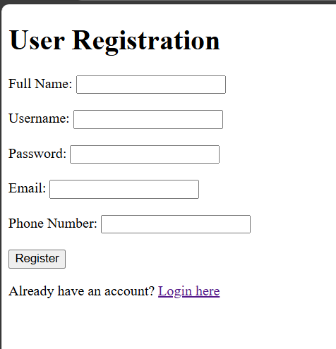
Registration Page

Slide 7
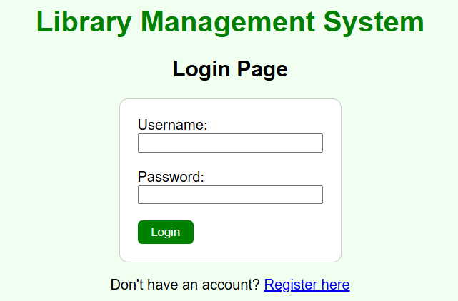
LOGIN PAGE

Slide 8
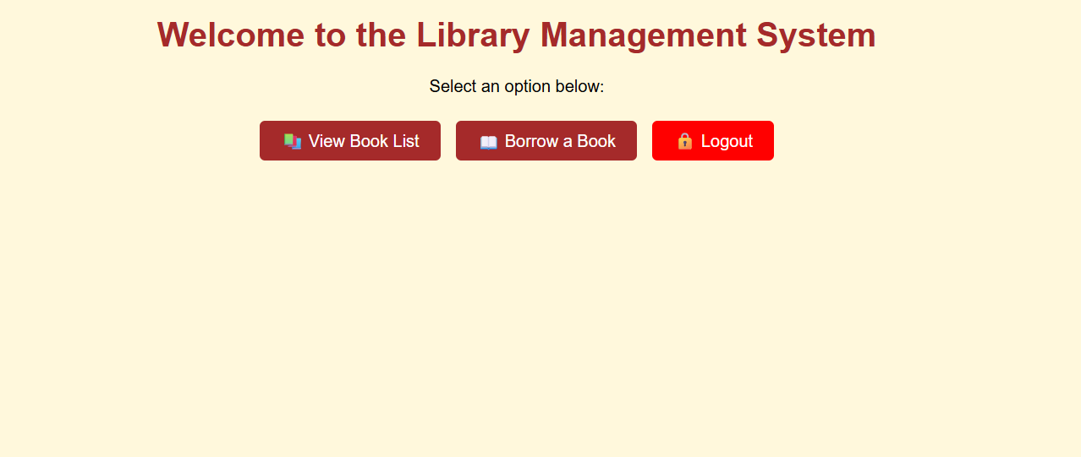
HOME PAGE

Slide 9
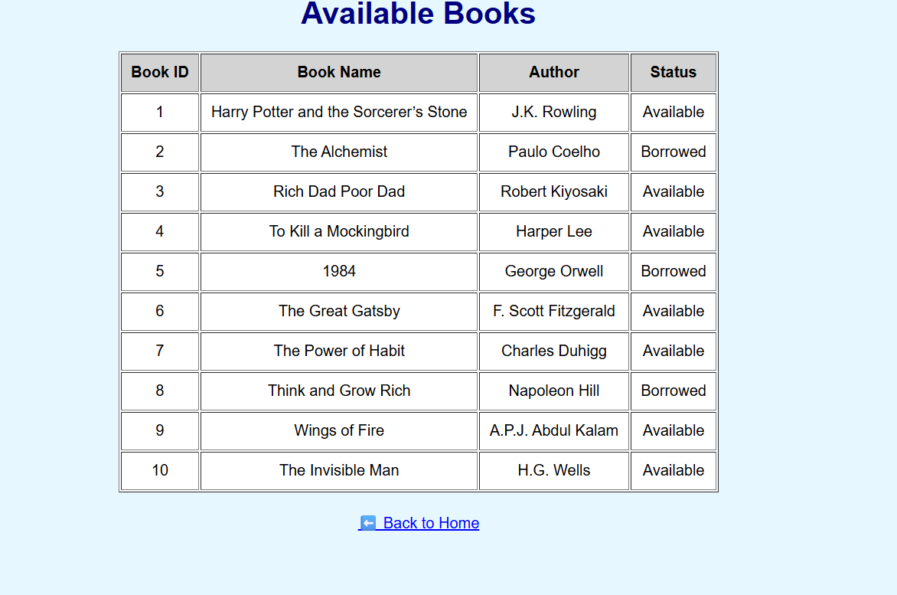
BOOKS LIST

Slide 10
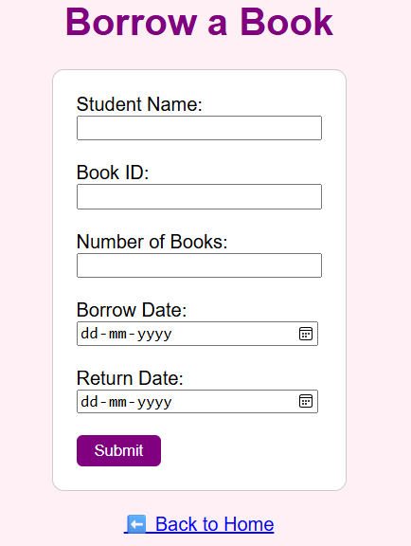
BORROW BOOKS

Slide 11

USER BENEFITS
Users can access the digital library anytime, from any device.
They can renew, reserve, or return books easily through a self-service portal.
Personalised recommendations help discover relevant books.
Notifications and alerts keep users updated on availability and due dates.

Slide 12

AUTOMATION&ANALYTICS
Automation speeds up cataloguing, checkouts, and returns. Fines and book statuses are updated automatically, minimising human error.
Analytics tools generate detailed reports on borrowing trends, popular titles, and missing books.
These insights help libraries make better purchasing and planning decisions.

Slide 13
IMPACT AND IMPLEMENTATION
Digital management saves time and boosts library performance.
60% reduction in admin work.
45% increase in book circulation.
95% user satisfaction from faster services. Implementation steps include planning, data migration, testing, and continuous improvement

Slide 14
CONCLUSION
The digital library management system transforms libraries into modern learning spaces.
It enhances accessibility, accuracy, and service quality for both users and librarians.
By adopting digital tools, libraries can better support education, research, and lifelong learning in the digital era

Slide 15

Thank
you

